Slide 1
Know This…
Capacitors in parallel (any number) are all at the same voltage V.
Capacitors in series (any number) all carry the same charge Q.
Putting these facts together with V = Q/C can solve a lot of problems!
.
V
V
Q
-Q
Q
-Q
C₂
C₁

Slide 2
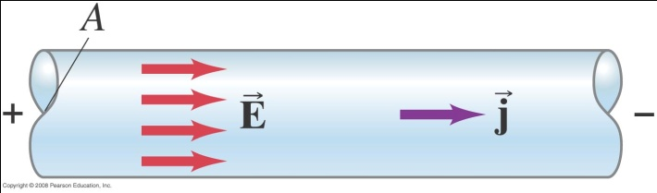
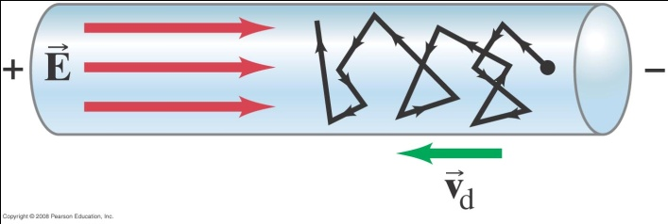
Microscopic Picture of Conductivity
The total current down the wire is I; if we assume it’s uniform over the cross section area A (which it is) there is a current density j = I/A. (units: amps/m²)
A constant E field gives a steady current. This means the electrons are bouncing off things, like a sloping pinball machine, otherwise the current would keep accelerating.

Slide 3
Question
What is the resistance of a 12V, 36 Watt headlight bulb?
3 ohms
4 ohms
0.3 ohms

Slide 4
Answer
What is the resistance of a 12V, 36 Watt headlight bulb?
3 ohms
4 ohms
0.3 ohms
Power of 36W = IV, V = 12 so I = 3. Then I = V/R.

Slide 5
Question
Assume the 12V, 36 Watt headlight bulb has a tungsten filament. What is its approximate power output in the first instant it is connected, cold, to the 12V battery? ( ).
36W
2.4W
540W

Slide 6
Answer
Assume the 12V, 36 Watt headlight bulb has a tungsten filament. What is its approximate power output in the first instant it is connected, cold, to the 12V battery? ( ).
36W
2.4W
540W
Power P = IV = V²/R: R when initially cold is 1/15 of R at operating temperature of 3300K.

Slide 7
Drift Speed
Take a piece of copper wire, say 1mmx1mm cross section, 1m long carrying 5 amps.
This is 1cc of Cu, about 10 gms, about 10²³ conduction electrons (one per atom), about 15,000C of electron charge.
Therefore, at 5 amps (C/sec) it takes 3000secs for an electron to drift 1m.
Bottom line: the drift velocity is of order 10⁻⁴ m/sec. (it’s linear in current, and depends on wire thickness for given current, obviously.)

Slide 8
Question
The resistivity of aluminum is 58% higher than that of copper.
A copper high voltage line has diameter 1 cm. If is replaced by an aluminum line of the same resistance, the aluminum line has diameter:
1.58cm
1.26cm
0.8 cm
O.64 cm

Slide 9
Answer
The resistivity of aluminum is 58% higher than that of copper.
A copper high voltage line has diameter 1 cm. If is replaced by an aluminum line of the same resistance, the aluminum line has diameter:
1.58cm
1.26cm
0.8 cm
O.64 cm
Remember R = ρL/A. The power lines have the same length, the aluminum therefore needs 58% more cross-section area A

